Slide 1


Correlation between general health and mental health
of Indigenous People
Course: Data Analysis for Python
Team Members:
Dylan Luong (5150921)
Iman Fatima Ghani (5152246)
Jehosua Alan Joya Venegas (5149910)
Saurodeep Majumdar (5153010)

Slide 2

Correlation between general health and mental health
of Indigenous People
Introduction
Project focus on Indigenous People
Mental and Physical Health
Housing: Need for repairs
Crowding: Persons per room
Indigenous People:
First Nations
Inuit
Metis
Tool used for impact analysis
Visualization by Tableau

Slide 3
Correlation between general health and mental health
of Indigenous People
Introduction
Characteristics:
Original Inhabitants of Canada
Community Oriented, Like Hunting and Gathering
Remote Communities, Less accessibility of housing amenities
First Nations – Residents of Reserve Land [5, 2]
Metis – No specific region. Mixed people of European and First Nation Descent [1]
Inuit - Inhabitants of Nunavut, Quebec, NFL, Northwest Territories [6]

Slide 4
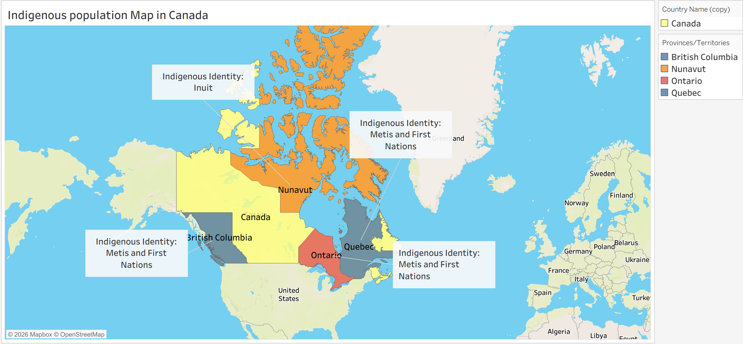
Indigenous Population Map in Canada

Slide 5
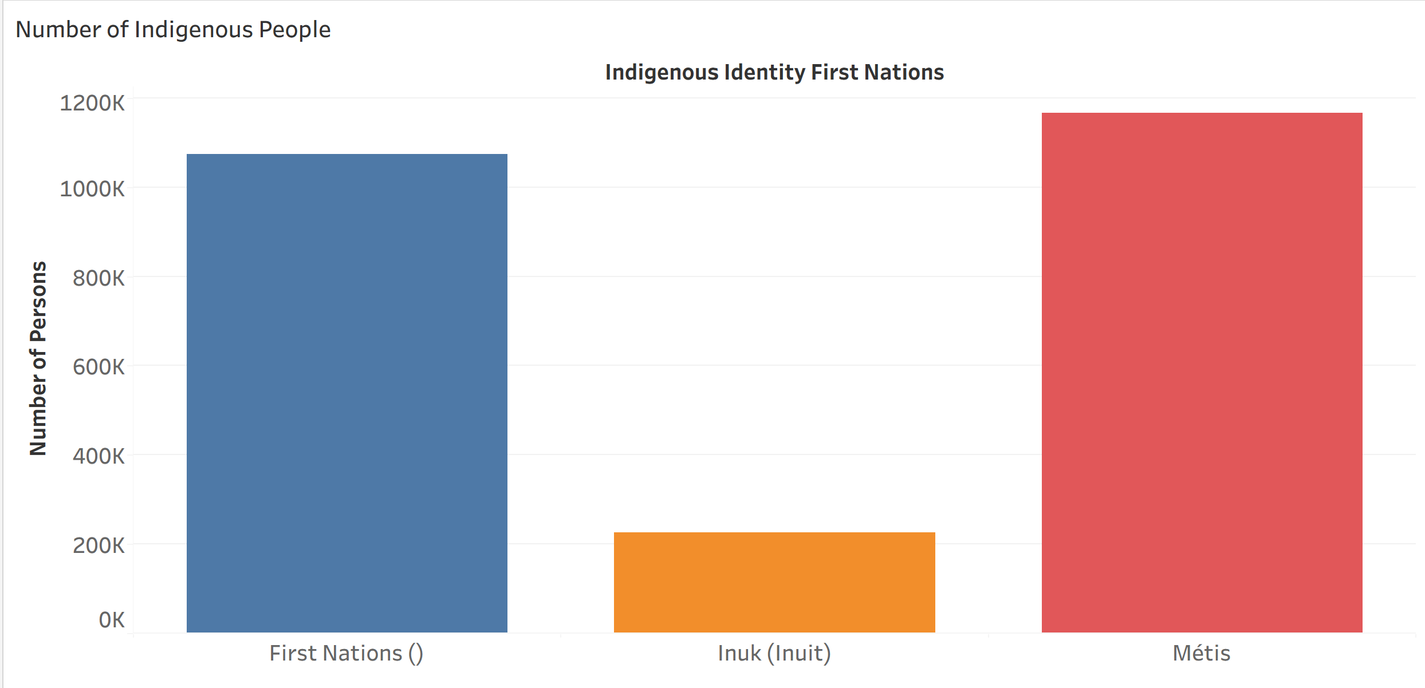
Population of Indigenous People
- Population Highest among Metis

Slide 6
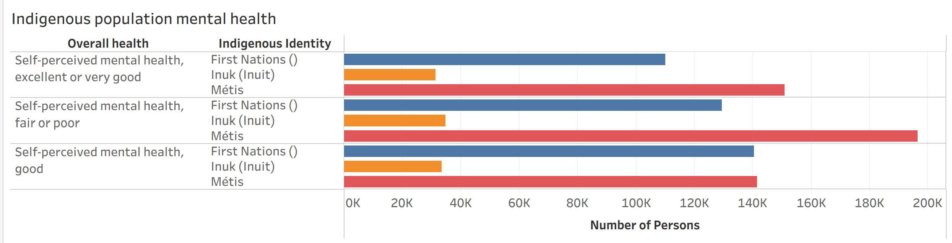
Indigenous Population Mental Health
Focus on Metis as they have the highest mental health related issues

Slide 7
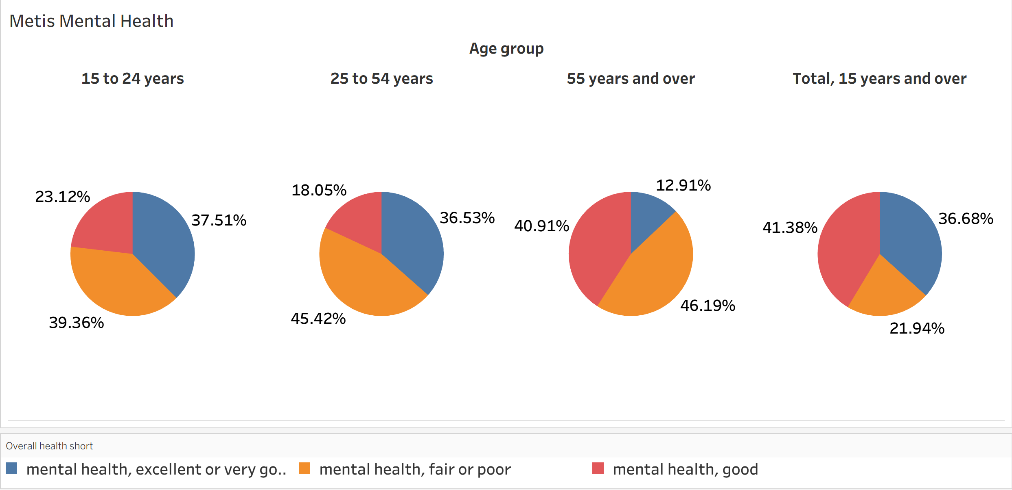
Metis Mental Health by Age Group
Metis Mental Health ( 25 to 54 years of age and 55 years and over)
45.42% and 46.19% of individuals have self-perceived mental health fair or poor

Slide 8
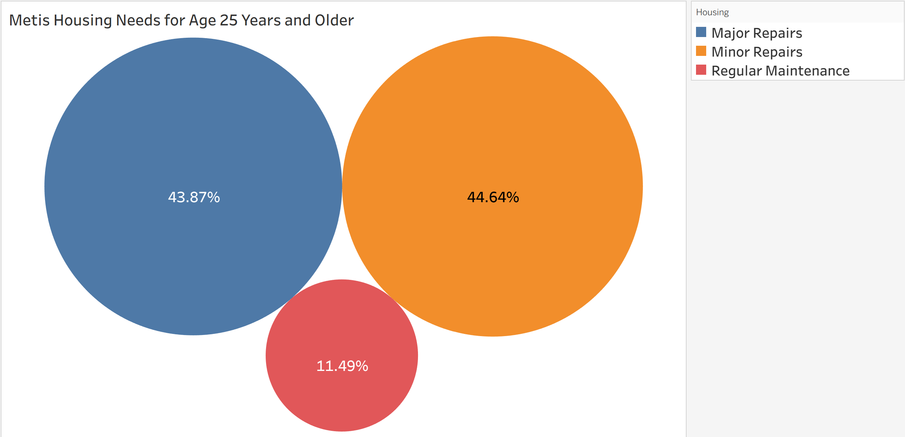
Metis Housing Needs
90% Major or Minor repairs needed to houses

Slide 9
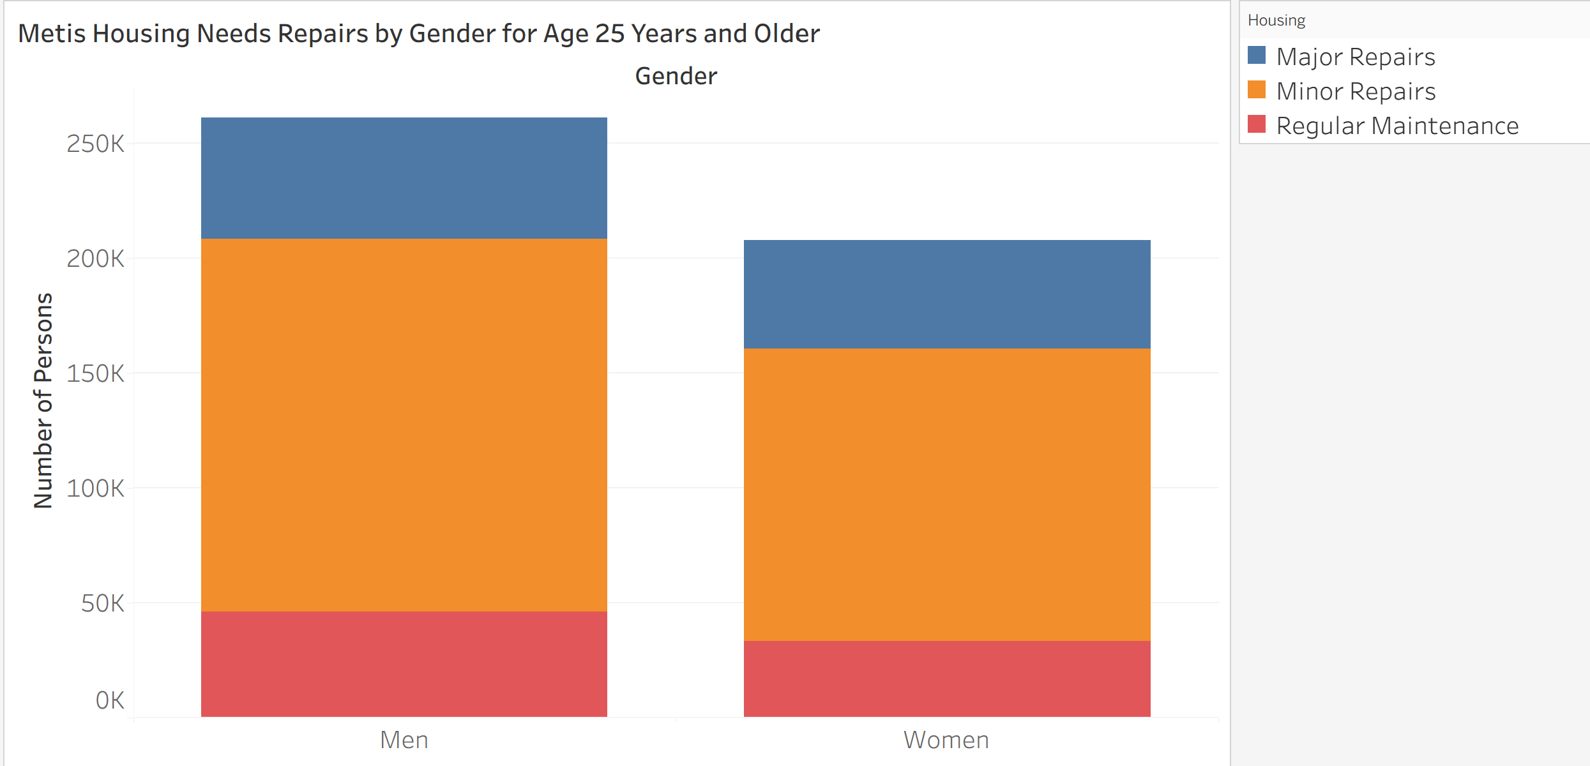
Metis Housing Needs Repairs by Gender
- Men are having more major or minor repairs needed

Slide 10
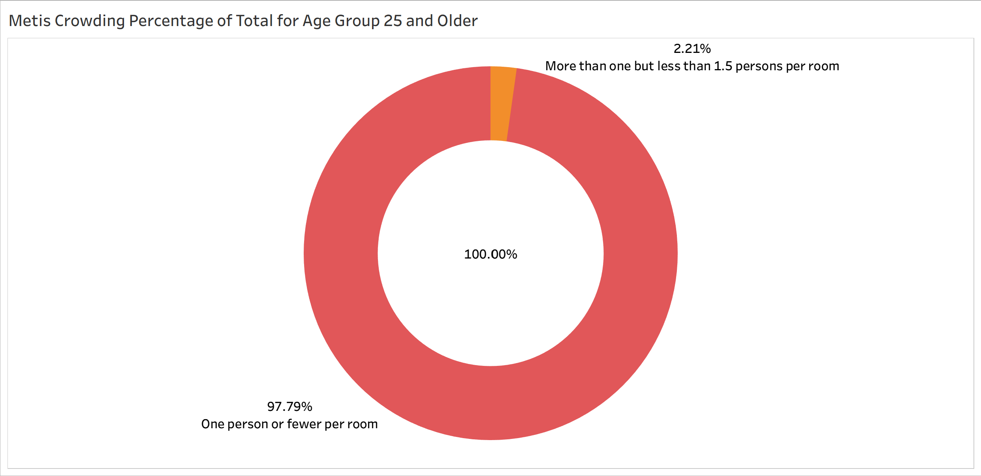
Metis Crowding
- Not much overcrowding present

Slide 11
Analysis and Conclusion
Metis people were found to have issues of mental health related to housing needs and within higher age groups
Metis and First Nations populations mainly residing in BC, Quebec and Ontario
Inuit people less population mainly residing in Nunavut
Overcrowding not a concern for Metis, First Nations and Inuit
Cause of mental health concerns and related to income $35,600 income of Metis vs Canadians $70,500 [9, 10]

Slide 12
References
[1] Who are the Metis?, [Online] Metis Nation of Ontario, Ottawa, ON. Available: https://www.metisnation.org/about-the-mno/culture-heritage/
[2] The Indian Act, [Online] The Canadian Encyclopedia. Available: https://thecanadianencyclopedia.ca/en/timeline/the-indian-act
[3] J.R. Miller, “Residential Schools in Canada,” Jan. 2024. Accessed: Apr, 9, 2026, [Online]. Available: https://thecanadianencyclopedia.ca/en/article/residential-schools
[4] Self-government, [Online] Government of Canada. Available: https://www.rcaanc-cirnac.gc.ca/eng/1100100032275/1529354547314
[5] R. Irwin, “Reserves in Canada,” Jan. 27, 2026. Accessed: Apr, 9, 2026, [Online]. Available: https://thecanadianencyclopedia.ca/en/article/aboriginal-reserves
[6] About Canadian Inuit, [Online] Inuit Taririit Kanatami. Available: https://itk.ca/about-canadian-inuit/
[7] Statistics Canada, [Online]. Available: https://www150.statcan.gc.ca/t1/tbl1/en/tv.action?pid=981002810
[8] Statistics Canada, [Online]. Available: https://www150.statcan.gc.ca/n1/pub/11-627-m/11-627-m2024019-eng.htm1
[9] Units of Latitude and Longitude, [Online] Astronomy Education at the University of Nebraska – Lincoln. Available: https://astro.unl.edu/naap/motion1/tc_units.html
[10] Locating Capital Cities – Key, [Online]. Available: https://www.edu.gov.mb.ca/k12/cur/socstud/foundation_gr6/blms/6-3-1e.pdf
[11] Join Your Data, [Online] Tableau. Available: https://help.tableau.com/current/pro/desktop/en-us/joining_tables.htm

Slide 13
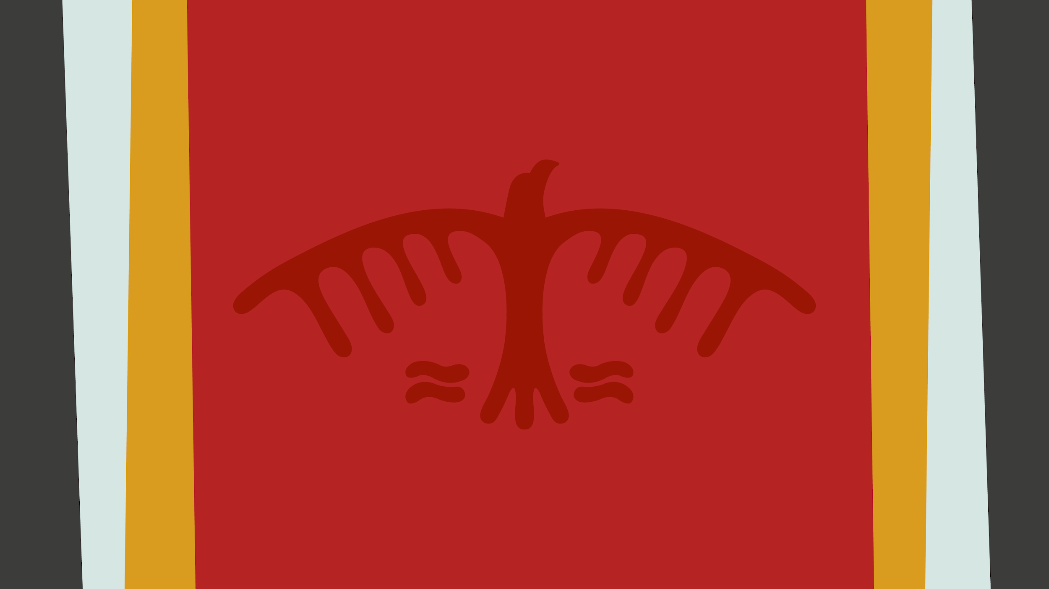
Chi-Miigwetch
Thank you

